Slide 1

WHAT IT TAKES TO WIN: NBA SPORT’S BETTING
Ryan, Buckley, Ben

Slide 2
BACKGROUND
Best published model has prediction accuracy of approx. 74%
Model Avg 66-72% accuracy – most focused on playoff scores
Dataset – NBA Game details for all games from 2004 to early 2020 season
Trained models on pre-2020 seasons, tested on 2020 season

Slide 3
KEY FEATURES
Field Goal Percentage Rolling Average
Free Throw Percentage Rolling Average
3-Pointer Field Goal Percentage Rolling Average
Total Assists Rolling Average
Total Rebounds Rolling Average
Averages of game metrics by Team per Season

Slide 4
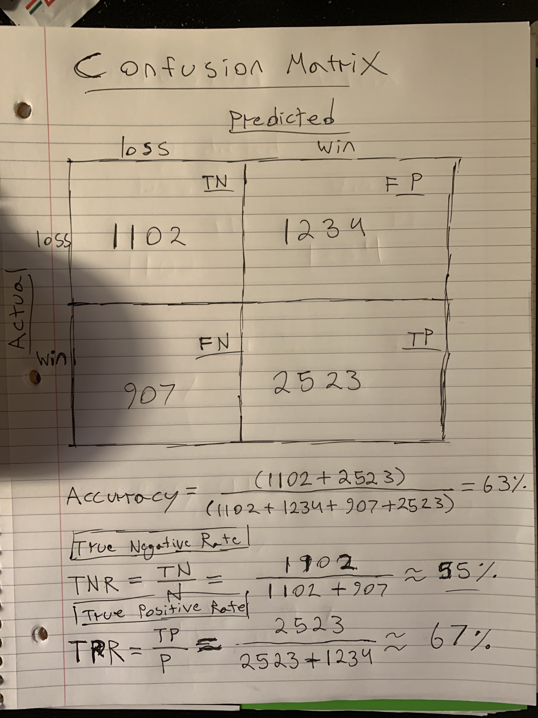
CONFUSION MATRIX
Accuracy: Model Performance
True Negative Rate: How accurate model was given that it predicted a negative (loss)
True Positive Rate: How accurate model was given that it predicted a positive (win)

Slide 5
MACHINE LEARNING MODELS
DecisionTreeClassifier ❌
47% Accuracy
LogisticRegression ❌
61% Accuracy (Testing)
51% Accuracy (Training)
XGBoost ❌
51% Accuracy
RandomForestClassifier ✅
55% Accuracy

Slide 6
WINNINGS
First Run
$370
Second Run
-$164
Total Winnings
$206

Slide 7
OTHER FEATURES TO EXPLORE
ELO Ratings
Recent Player Performance
Player Season Performance

